Slide 1
The Economic Burden of Youth Experiencing Homelessness and the Financial Case for Investing in Interventions to Change Peoples’ Lives
Steven Foldes, Ph.D.
Principal, Foldes Consulting LLC
Adjunct Associate Professor, Epidemiology and Community Health, University of Minnesota
Andrea Lubov, Ph.D.
Independent Consultant
May 19, 2016
Notes:
To begin, I’d like to acknowledge my co-author Andrea Lubov, and thank the YouthLink board and staff, our advisory group, and the many people and organizations who contributed data and expertise to our work. They are all identified in the full report, available at youthlinkmn.org/the-cost-of-homelessness/
I would like to acknowledge our funders:
Otto Bremer Foundation
Hearst Foundations
Blue Cross and Blue Shield of Minnesota Foundation

Slide 2
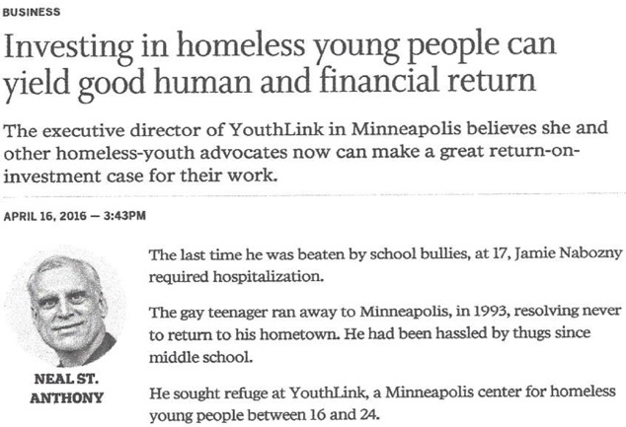
Notes:
Our report has received attention in the media, for which we are grateful, because we are attempting to start a much needed conversation about the economics of youth homelessness.

Slide 3
Behind the Headlines
Questions that motivated our work
2011 YouthLink Cohort
Link to “opportunity youth”
Results: 2 tables and 2 charts
Economic burden of cohort members
2011 and over time
Fiscal expenditures on interventions
Break-even analysis
Implications
Notes:
In this presentation we will go behind the headlines for a brief look at our results.
I will begin with the questions that motivated our work.
Then I will introduce you to YouthLink and the 2011 YouthLink cohort, the group we investigated for this project. I will discuss how this cohort is a part of what some have called “opportunity youth.”
I will summarize our results in two tables and two charts, focusing first on the economic burden of the cohort members in 2011 and then over time from ages 16 to 64.
I will describe the fiscal expenditures on interventions for the cohort in 2011.
Finally, I will present the break-even analysis and discuss the implications of our findings.

Slide 4
Our Questions
Among a cohort of YouthLink clients, what are the comprehensive, long-term excess costs of youth experiencing homelessness?
How many youth would need to become self-sufficient financially in order to offset the fiscal cost for a year of the interventions we provide to all of them?
Notes:
We addressed two questions in this study.
First, we estimated the comprehensive, long-term costs to taxpayers and to society of youth experiencing or at risk of homelessness.
By comprehensive, we mean the costs across a wide range of sources.
By long-term, we mean costs from age 16 to 64.
By excess, we mean costs above and beyond costs for youth in the general population.
Second, we performed a break-even analysis to estimate the potential cost offset due to youth becoming financially self-sufficient.

Slide 5
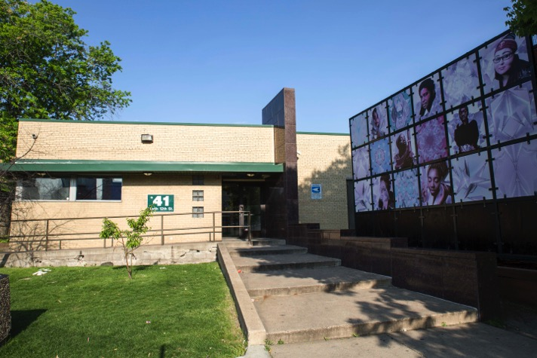
YouthLink
Minneapolis drop-in center—part of our crisis response system for youth experiencing homelessness
Since 2011, home of the Youth Opportunity Center—a collaborative service model that brings together a variety of agencies to serve youth in one location
2,000 visitors annually
Notes:
This is YouthLink, Minneapolis’ largest drop-in center, and part of our safety net for youth experiencing homelessness.
We focus on 2011 because that is the year YouthLink began it’s current form as home of the Youth Opportunity Center, a collaborative model that brings together more than 30 agencies to serve youth in one location, a one-stop-shop approach to social services.
YouthLink receives about 2,000 unique visitor annually.

Slide 6

2011 YouthLink Cohort
1,451 non-disabled youth
Ages 16-24, median = 20
58% female
91% youth of color
53% failed to graduate
high school at age 18-24
59% reported earnings in 2011;
mean = $3,930 ($8.16 per hour)
Notes:
We focus our study on 1,451 visitors to YouthLink in 2011 who were non-disabled, or not eligible for Supplemental Security Income (SSI). Those eligible for SSI have different life chances. So, presumably, the 1,451 youth in our cohort are, in theory, capable of becoming financially self-sufficient.
You see here some key demographic characteristics of the cohort. Most notably, these were 91% youth of color, primarily African-American, compared to 36% youth of color in Hennepin County. This concentration by race is not an accident. It is the consequence of racism in our society.
The fact that these youth are far behind in school and earning very little are critical features of their circumstances, and make them…

Slide 7
Ground Zero
Racial disparities
Achievement gap
Poverty and income inequality
Social determinants of health
Public safety
Disconnected Youth
Notes:
Ground Zero for racial disparities, the achievement gap in our schools, and for poverty and income inequality in our communities. Because of those things, they are examples of the social determinants of health and problems for public safety.
So, while our focus is on a small group of youth, this is a group whose existence has large implications for our society.
My academic colleagues refer to this group using the more dispassionate term “disconnected youth,” since they are disconnected from education and employment during the crucial ages of 16 to 24.
This problem has been extensively studied in Europe, where these youth are called NEET, not in education, employment or training.

Slide 8
White House Council for Community Solutions
Notes:
In the US, this group received attention from the White House Council for Community Solutions, appointed by President Obama in 2010.
They engaged Clive Belfield and his colleagues to estimate the number of disconnected youth in the US, which they called “opportunity youth,” and estimate the economic burden they posed to our country. This study, released in 2012, received substantial attention nationally.
Belfield and colleagues estimated that there were some 6.74 million opportunity youth in 2011, fully 17 percent of all youth in this age range. They estimated that the aggregate taxpayer burden for each cohort of opportunity youth over their lives from age 16 to 64 to be $1.56 trillion in present value terms. The aggregate social burden is $4.75 trillion. These costs ‘roll over’ each year because each year brings a new cohort of opportunity youth. I would suggest that this alarming finding is a national disgrace.
We attempted to build on the approach Belfield and colleagues used to estimate the economic burden of opportunity youth, but we focused our estimates on the 2011 YouthLink cohort and developed our estimates using local data wherever possible for their short-term costs from ages 16 to 24. But we relied on Belfield’s estimates of the cost of opportunity youth for ages 25-64 as part of our estimate of long-term costs for the 2011 YouthLink cohort.
The reader is directed to the full report for a detailed discussion of research methods and limitations.

Slide 9
Annual fiscal and social costs of YouthLink 2011 cohort, per person and as a cohort.
Notes:
In order to be able to combine our estimates of short-term costs with Belfield’s estimates of long-term costs we built our cost estimates following Belfield’s categories, first estimating the cost in 2011 of the cohort.
These are the categories of cost we investigated, which are the same ones that Belfield looked at.
But because our cohort is homeless or at risk of becoming homeless, we also added costs related to public support for housing them during the year.
Like Belfield, we estimated the total costs for the cohort and also expressed them in average per person costs, and looked at costs to taxpayers and to society at large.
Remember that the costs you see represent estimated excess costs, beyond what costs are for average youth in the general population.
In the interest of time I won’t go over each cost category right now. Each of these categories represents a mini study, and these are detailed in the full report. Take, for instance, welfare transfer payments.

Slide 10
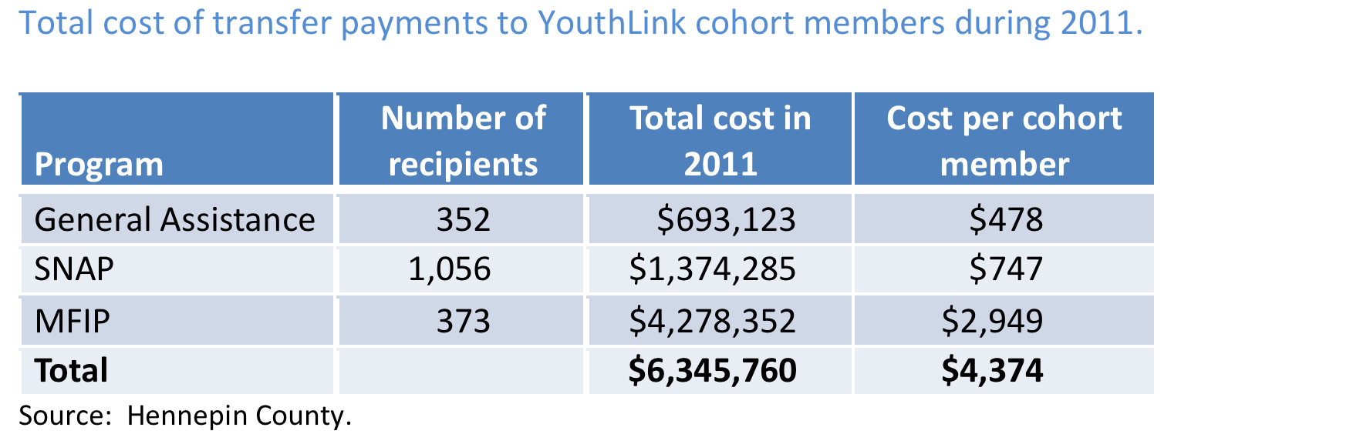
Notes:
This table from the full study summarizes the welfare transfer payment to the cohort. We looked at General Assistance, SNAP and MFIP, Minnesota’s welfare program. We found that the cohort used $6.3 million in these benefits.

Slide 11
Annual fiscal and social costs of YouthLink 2011 cohort, per person and as a cohort.
Notes:
That’s the total that landed in our table for this category of costs, and we filled this table out in the same way.

Slide 12
Annual fiscal and social costs of YouthLink 2011 cohort, per person and as a cohort.
Notes:
Here’s the full table. I won’t go over this in detail, but I do want to point your attention to the largest cost drivers. These are public expenditures for crime, welfare transfer payments, and public support for housing cohort members.
The 2011 total for the cohort was nearly $25 million in excess fiscal costs, or an average of a little over $17,000 per cohort member.
Public support for housing contributed 14.5 percent of excess fiscal costs.
It is important to understand that this is the annual amount for 2011, and these costs recur each year because each year there are a similar number of YouthLink clients in this age group, and each client can remain in this group for up to nine years, although few remain connected to YouthLink for that long.

Slide 13
Present value of the estimated immediate (5-year), long-term and lifetime fiscal costs of the 2011 YouthLink cohort.
$248,182
$77,442
$170,740
Age
16 24 25 64
Cohort of 1,451 Per person
$112,400,468
$247,743,740
$360,144,208
Notes:
Once we established the estimated annual fiscal and social costs of this cohort, we transformed the annual costs into costs over time in order to estimate the lifetime burden. This arrow represents age in years, from 16 to 24, then from 25 to 64. I will show you these costs per person and for the entire cohort.
First, we estimated the “immediate cost burden” for ages 16 to 24 by calculating the present value of the stream of five years of annual costs using a discount rate of 3.5 percent. We calculated the stream of costs for five years because that is the average amount that any current, specific youth will likely be a cohort member.
Based on the estimated annual totals I just showed you, the immediate fiscal 5-year excess costs for the cohort are $112.4 million, or $77,400, per person. These amounts represent the economic burden of the YouthLink 2011 cohort over the 16-24 age range.
Directly estimating the long-term (ages 25-64) costs of disconnection is challenging and was beyond the scope of our effort focusing on the YouthLink 2011 cohort. One reason we closely followed Belfield and colleagues’ approach to estimate the annual and immediate costs of the YouthLink cohort was to be able to apply their long-term cost estimate. Another reason was that even if it had been in the scope, some of the data sets that Belfield and colleagues used to estimate the long-term costs are not available in more localized form. In the white paper we discuss at some length our rationale for using Belfield’s long-term costs, which are conservative and do not include excess lifetime housing costs.
Applying Belfield and colleagues’ long-term individual estimates of $170,740 for the fiscal costs to the 1,451 members of the YouthLink 2011 cohort, yields excess fiscal costs for the entire cohort of $247.7 million. All costs have been computed using a 3.5 percent discount rate.
Adding the immediate and long-term estimated costs, our estimates of the lifetime fiscal burden of the YouthLink 2011 cohort is approximately $360.1 million, or $248,000 per person.

Slide 14
Present value of the estimated immediate (5-year), long-term and lifetime social costs of the 2011 YouthLink cohort.
$613,182
$84,152 $529,030
Age
16 24 25 64
Cohort of 1,451 Per person
$122,130,139 $767,622,530
$889,752,669
Notes:
This is the same chart, but focused on costs to society, again following Belfield’s approach to allocating the expenses we identified. It shows that our estimate of the lifetime social burden of the YouthLink 2011 cohort is approximately $889.8 million, or $613,000 per person.

Slide 15
Conclusion
The comprehensive, long-term
costs to taxpayers and society
are huge!
Notes:
Our first conclusion…
But there is better news in the break-even analysis.

Slide 16
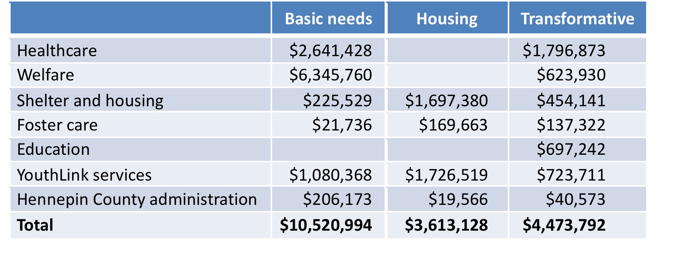
Break-even Analysis
Expenditures for basic needs, housing and transformative services, 2011.
$18.6 million
Notes:
Now I will show you a table and a chart that summarizes the results of our break-even analysis.
Our objective here was to estimate how many YouthLink clients would need to change the trajectory of their lives to become self-sufficient financially in order to cover the fiscal cost for a year of the interventions designed to help them become adults who do not need to rely on government supports.
We added up all of the intervention costs, and added Hennepin County administrative costs as well. However, we excluded criminal justice expenses from these intervention costs because the criminal justice system is not designed to support homeless youth through meeting their basic needs, providing housing, or to make them less dependent on government supports. We think of the cost of the criminal justice system as the price our society pays for the existence of homeless youth.

Slide 17
Break-even Analysis
Basic Needs: Meet day-to-day needs
Welfare, physical health services, temporary shelter, YouthLink drop-in services
Housing: Establish housing stability
Supportive housing, youth shelters, Emergency Assistance, YouthLink staffing of supportive housing
Transformative: Help youth change their lives
Education, jobs skills training, YouthLink case management, MH/CD services
Notes:
We did our best to divide the expenditures into three basic categories: basic needs, housing and transformative services.
Basic Needs: These are a range of expenditures intended to meet the day-to- day needs of youth experiencing or at risk of homelessness, such as welfare transfer payments, healthcare services other than for mental health and chemical dependency treatment, temporary shelter and YouthLink drop-in services.
Housing: This category includes costs incurred to house youth experiencing homelessness, with the goal of establishing housing stability. Examples include fiscal expenditures on supportive housing, youth shelters (which are similar to supportive housing), Emergency Assistance (a State program of limited financial support to prevent the loss of a home), the Youth Mobile Team (which works with apartment owners and older youth to find hard-to-place youth in homes) and YouthLink services related to housing (which includes management of three supportive housing sites).
Transformative Services: These expenditures are designed to help youth change their lives through mental health and chemical dependency treatment, education, welfare support programs such as job skills training, and case management by YouthLink and other staff.

Slide 18
Expenditures for basic needs, housing and transformative services, 2011.
$18.6 million
43%
Notes:
As shown on this table, an estimated $18.6 million was spent in 2011 to support the YouthLink 2011 cohort, or about $12,800 per youth.
It’s important to recognize that of the total intervention expenditures of $18.6 million, a total of $8.1 million, or 43.5 percent, was spent on housing and transformative services. Most expenditures were simply to meet the basic needs of these youth.

Slide 19
Break-even Analysis
Knowing
the long-term fiscal cost of the cohort
what we spent on interventions in 2011
How many youth would need to become financially self-sufficient to offset the annual cost of all interventions for the entire cohort?
Notes:
Now, knowing the long-term fiscal cost of the cohort and what we spent on interventions in 2011, we can do a break-even analysis. We can ask the question, how many youth would need to become financially self-sufficient to offest the annual cost of all interventions for the entire cohort?

Slide 20
Notes:
Based on these estimates, this chart indicates the number of youth whose lives would need to change to become self-sufficient, productive adults in order to cover the cost of one year of the interventions.
For the purpose of this break-even analysis, we assume that change occurs at age 20. The estimated net present value of potential savings on each youth is then $211,059, and the height of the line reflects an increase of that amount for each youth in the cohort.

Slide 21
Notes:
As shown in the chart, a full year’s intervention costs for all transformative services can be covered if 22 youth (1.5 percent of the cohort) were to become self-sufficient, productive adults, beginning at age 20.
Only 39 transformed youth (2.7 percent of the cohort) are required to cover the costs of the housing and transformative services for the entire cohort, counting only the expenditures designed to help youth change their lives.
If 89 cohort members (6.1 percent) were to become economically self-sufficient by age 20, over time we would cover the full year’s cost of all transformative, housing and basic services to all cohort members. This is the break-even point.
Finally, should the interventions succeed in helping more youth, the costs to taxpayers that could be avoided would be substantial. For instance, if 290 cohort members, one in five, were to become economically self-sufficient by age 20, over time we would cover the full year’s cost of all transformative, housing and basic services to all cohort members and avoid $42 million in expected expenditures.
Now these savings would not occur instantaneously. The savings would accrue over more than four decades, but we are showing the net present value of the potential savings.
Of course, people seldom change as dramatically as assumed in this exercise, but this analysis suggests the potential value of transformative interventions to taxpayers if the interventions can successfully alter the life trajectory at this relatively early point in their lives of only a small number of youth experiencing or at risk of homelessness. These savings can potentially multiply, as each year brings a new cohort of youth who experience or are at risk of becoming homeless.

Slide 22
The costs are substantial…
…the break-even is low.
Notes:
Our second conclusion…

Slide 23
Implications
Youth experiencing homelessness…
A large but hidden problem.
We look away from the human costs.
We don’t understand the full economic costs.
Crystalizes the inequities in our society.
Largely “disconnected youth.”
Overwhelmingly persons of color.
Face disproportionately large barriers to becoming financially self-sufficient.
Notes:
Youth experiencing homelessness…
Is a large but hidden problem.
We tend to look away from the human costs, of lives that fall far short of their potential, and of the lives damaged by broken families, poverty, racial discrimination, addiction, criminal activity, health and mental health problems, sexual exploitation, boredom and meaninglessness.
We don’t understand the full economic costs. In speaking with many people in the course of doing this research, we were struck by the fact that people knew, of course, their own organization’s expenditures on behalf of these youth, usually over the course of a year. But it seemed that no one had a clue about the comprehensive costs to taxpayers and society, much less the costs over the adult lifetimes of these youth.
Crystalizes the inequities in our society.
They are largely “disconnected youth,” far behind on educational achievement and workforce participation.
Not coincidentally, homeless youth are overwhelmingly persons of color. Remember that the YouthLink 2011 cohort is 91 percent youth of color, predominantly African-American.
They face disproportionately large barriers to becoming economically self-sufficient.

Slide 24
What We Need to Understand
Youth ages 16-24…
Are at a critical stage in the life cycle.
If disconnected through age 24, their chance for an independent life diminishes dramatically.
This is a critical window of opportunity to avoid a lifetime of economic dependency.
Notes:
Youth ages 16-24…
Are at a critical stage in the life cycle, and should be building their social capital through educational achievement or gaining work experience and developing economic independence. Instead, they are worrying about where their next meal will come from and where they might spend the night. They are way behind their peers in the process to achieve financial self-sufficiency.
If disconnected through age 24, their chance for an independent life diminishes dramatically.
That’s why this is a critical window of opportunity to help these youth change their lives to avoid a lifetime of economic dependency.

Slide 25
Our Conclusion
Not funding transformative interventions is shortsighted.
With such a low break-even, funding interventions is low risk; we can afford to be bold.
This presents an investment opportunity, not only to help these youth, but to save ourselves a tremendous amount of money.
The lifetime cost of inaction is enormous.
Notes:
Not funding transformative interventions is shortsighted.
Helping just a small fraction of youth experiencing homelessness to change their life trajectories will, over time, repay the annual cost of all interventions we offer.
This presents an investment opportunity, not only to help these youth, but to save ourselves a tremendous amount of money.
I’d like to offer a footnote to this point. The economist Art Rolnick has helped us understand that funding preschool may have the best return on investment for our society, though of course he hasn’t seen our data. I doubt many of us would disagree with Art on the social value of preschool. But preschool isn’t a solution for every child. For a variety of reasons, and regardless of their preschool experiences, some kids will end up at YouthLink. With those kids, this is a critical window of opportunity to make a difference, so it is also a critical investment opportunity.
Because the lifetime cost of Inaction is enormous.

Slide 26

We Can Do This
With appropriate resources, YouthLink and others can help youth change their lives.
Many youth want to succeed.
There are many examples of success.
Yet, more than half of what we spend just supports basic day-to-day needs, not life changing assistance.
Notes:
With appropriate resources, YouthLink and other such organizations can help youth change their lives.
Changing lives is a heavy lift, but many youth want desperately to succeed. They often come in to YouthLink in crisis, hurt and angry and sorry for themselves. But over time, with the help of YouthLink’s case managers, many of them begin to assess their circumstances, seek the help they need, and find that youthful energy to change their lives.
And there are many examples of success; here’s an example of YouthLink’s high school graduation.
Yet, more than half of what we spend on youth experiencing homelessness just supports their basic day-to-day needs, not helping them change their lives.

Slide 27

If We Succeed…
Reduce
School achievement gap
Racial disparities
Poverty
Improve
Public safety
Social determinants of health
Provide workers to address the impending labor shortage
Improve the lives of many young people
Notes:
If we succeed with them, we also reduce the achievement gap in our schools, the racial disparities in our communities, and levels of poverty. We also improve public safety and the social determinants of health.
Equally important, we provide thousands of workers to address the anticipated labor shortage in Minnesota.
Not least, we improve the lives of many young people who have had a very rough start in their life journeys.

Slide 28
Three Takeaways
Thank our supporters for not looking away.
Encouraging that we have an office to end homelessness and an interagency effort
Change our thinking: What we spend is not “charity,” but an “essential investment.”
Challenge our elected officials, business leaders and private funders to increase their support for supportive housing and transformative services.
Notes:
Three takeaways:
We thank our supporters for not looking away from the human catastrophe of youth homelessness and for funding a safety net for these youth.
We need to stop thinking of the support we provide for youth experiencing homelessness as ”charity” and start thinking of it as an “essential investment,” not only in human terms but also in economic terms.
We need to challenge our elected officials, business leaders and private funders to increase their support for supportive housing and transformative services. Human decency requires that we meet the basic needs of vulnerable youth who are experiencing homelessness. But the services that we need to invest in are supportive housing and the range of transformative services, because these have the potential to help many of these youth become self-sufficient and to save taxpayers and our society a tremendous amount of money.

Slide 29
On Closing
Thank our funders
Otto Bremer Foundation
Hearst Foundations
Blue Cross and Blue Shield of Minnesota Foundation
Full report, presentation, infographic, whiteboard video available at:
youthlinkmn.org/the-cost-of-homelessness/
Further information:
Steven Foldes, Ph.D.
Foldesconsulting.com
Steven.foldes@foldesconsulting.com

